Slide 1

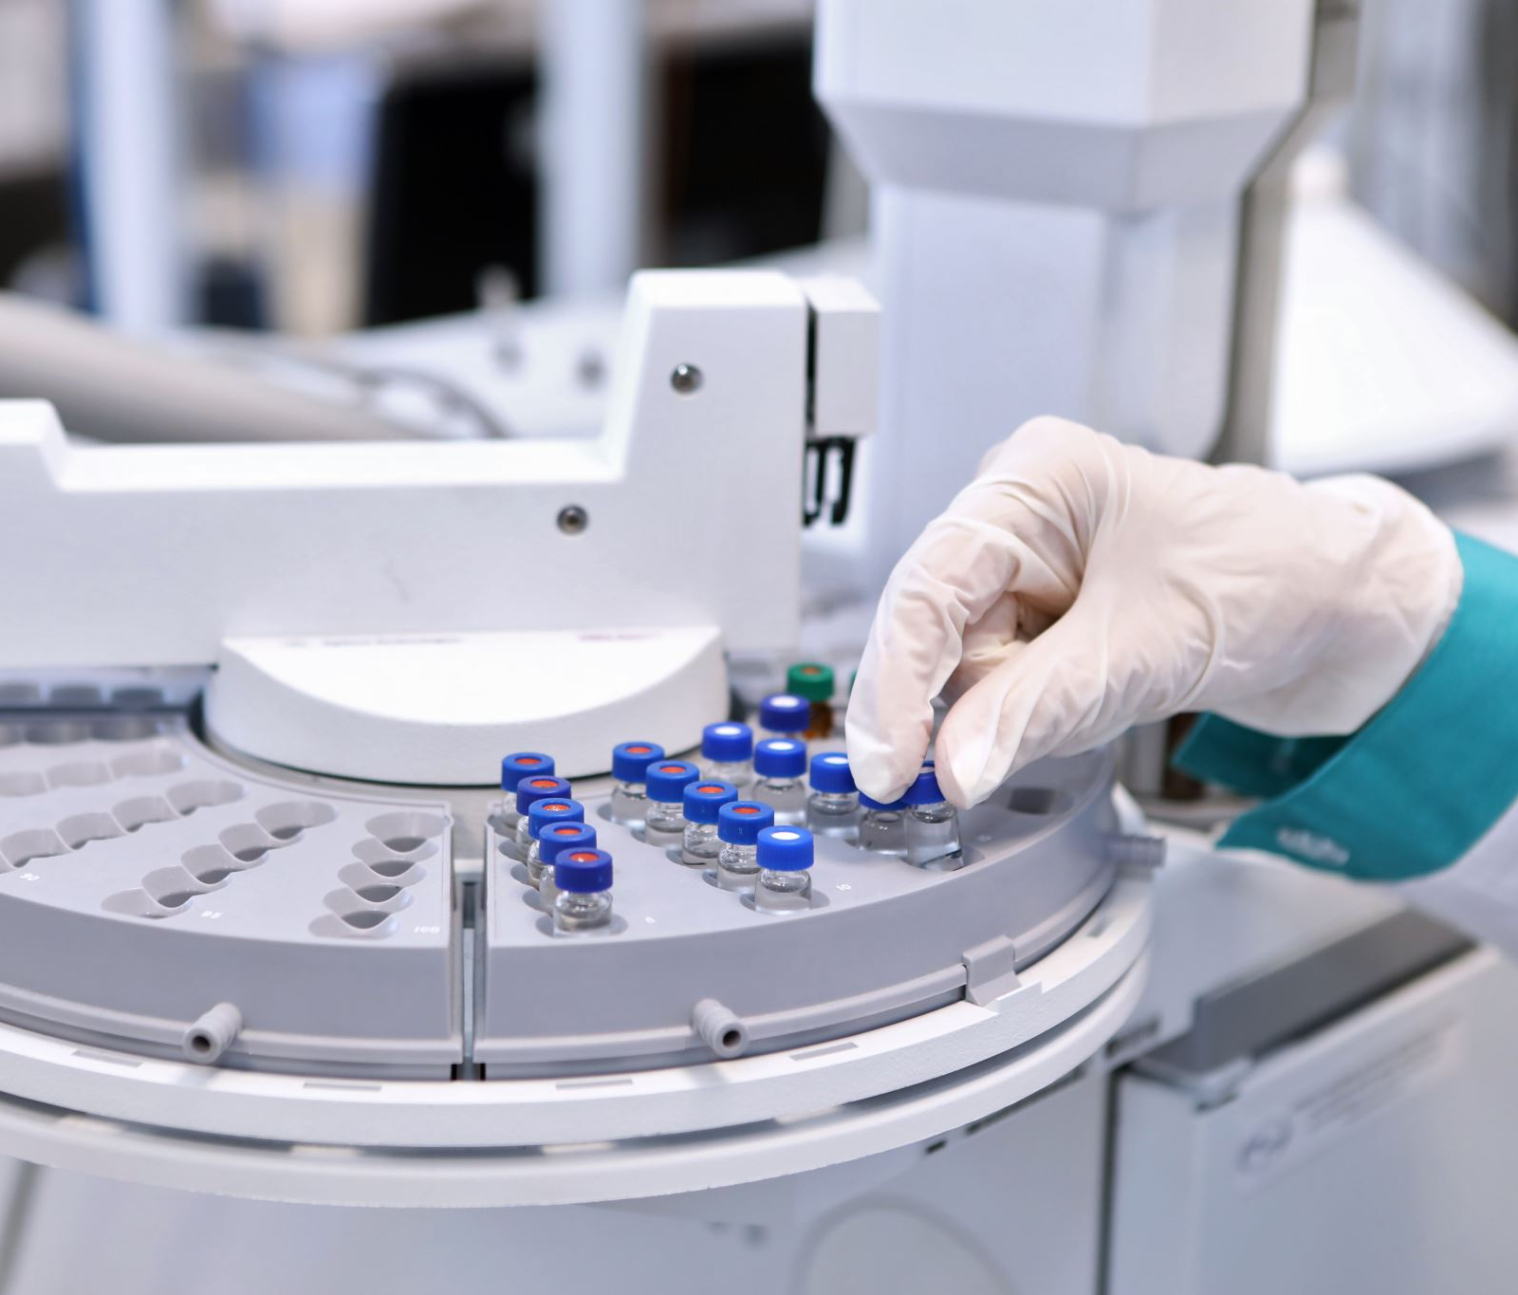
VariantSurvival: A tool to identify genotype-treatment response

Slide 2



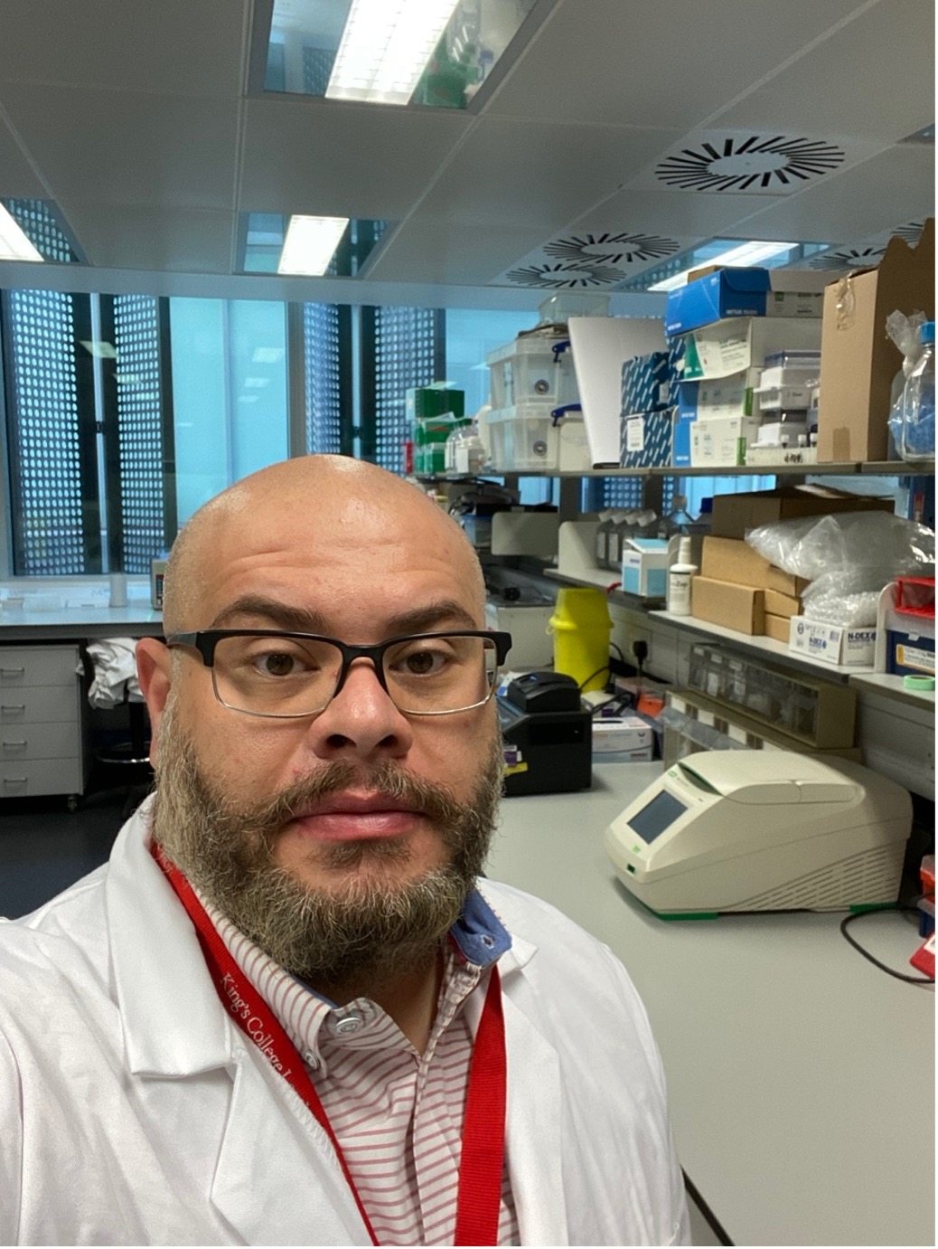

The Team

Slide 3


Slide 4
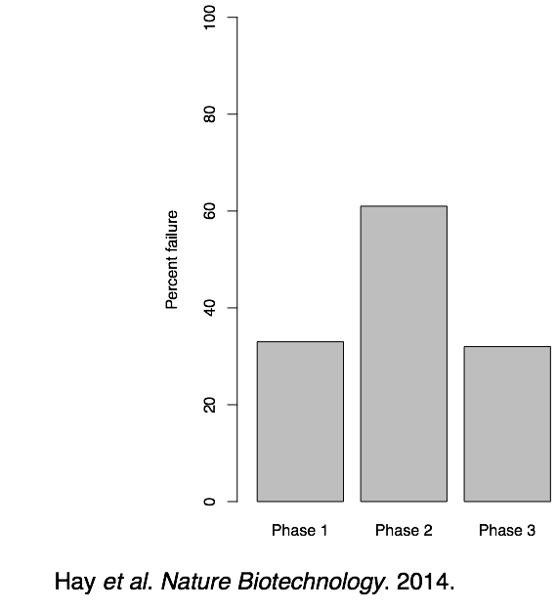
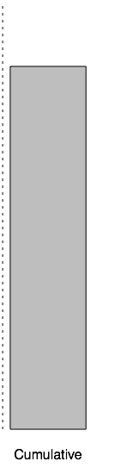
Drug development rarely succeeds…
Nearly 85% of candidate drugs that enter clinical trials fail
Failure happens often in late phase due to lack of efficacy

Slide 5

How can we reduce clinical trials failure?

Slide 6
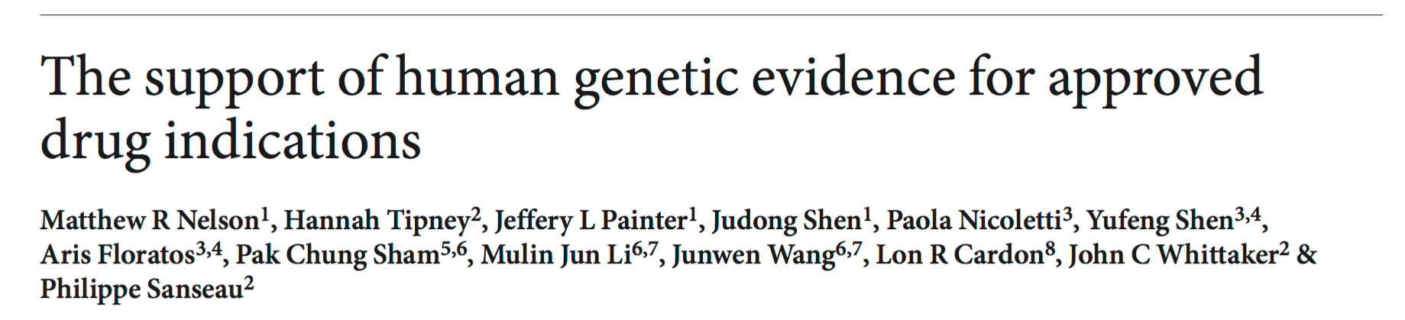
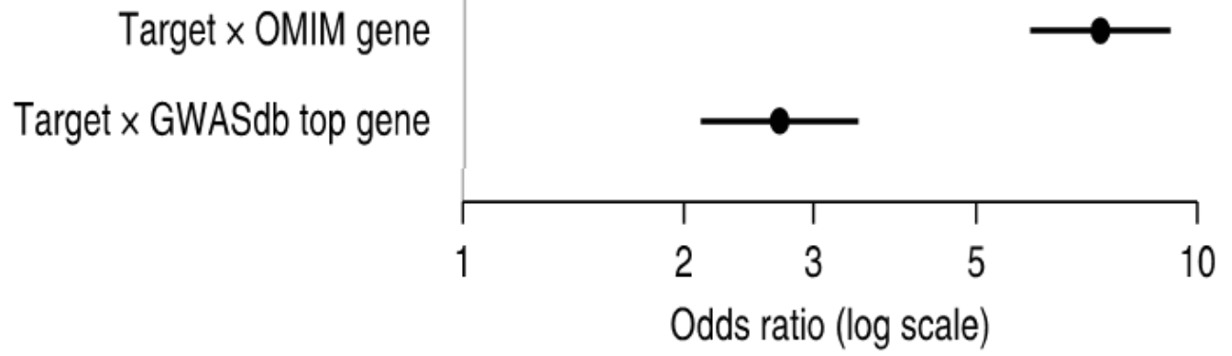
Genetics increase chances of success
Nelson et al. , Nature Genetics, 2015
Drug is ~8x more likely to succeed if target identified in Mendelian genetic evidence
Drug is >2x more likely to succeed if target is supported by GWAS evidence

Slide 7

Major challenge
Systematic strategy to integrate disease-associated variants with functional genomic and drug datasets to provide insight into disease pathogenesis and guide drug discovery and clinical trials for complex traits

Slide 8

PRELUDE trial of lithium in ALS
Original lithium trials were all negative
Combined results of 3 of these by genotype
Shows benefit of lithium in people with a specific genetic background

Slide 9
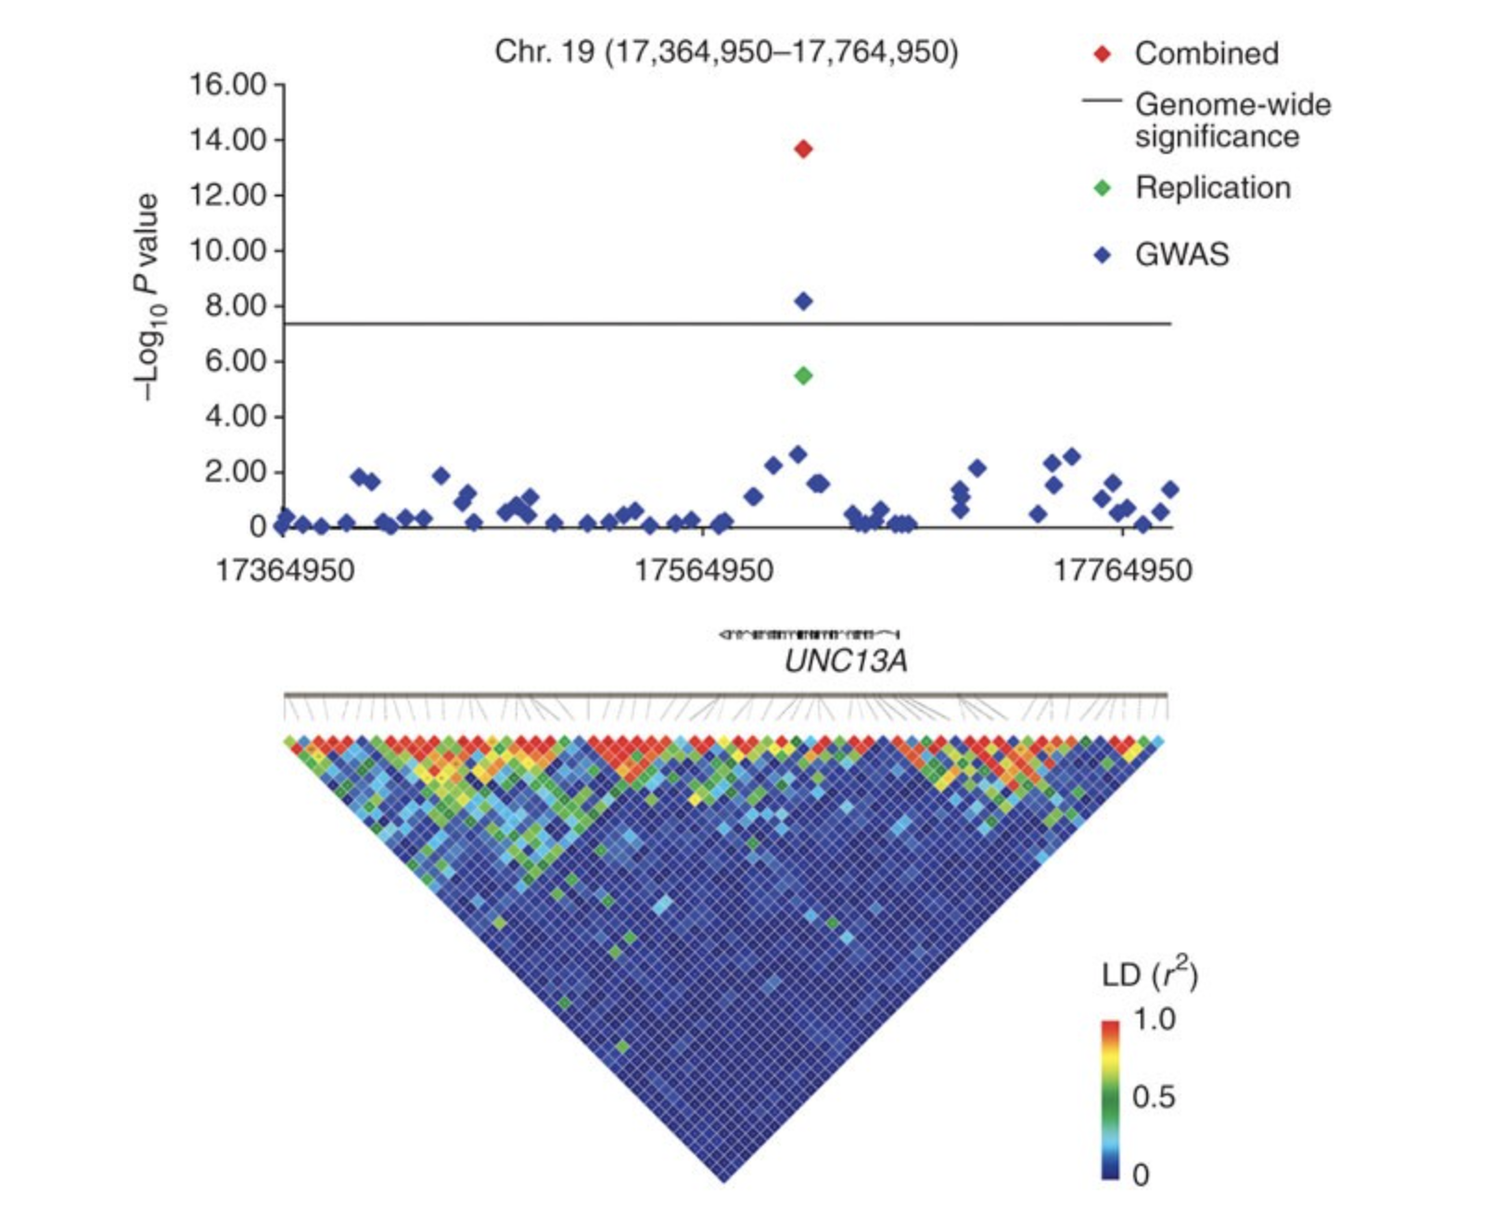
PRELUDE trial of lithium in ALS
Original lithium trials were all negative
Combined results of 3 of these by genotype
Shows benefit of lithium in people with a specific genetic background

Slide 10
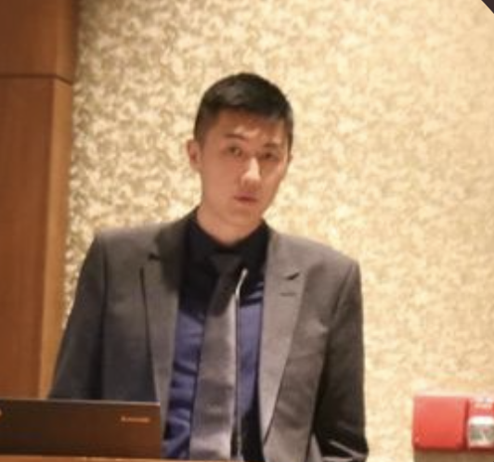
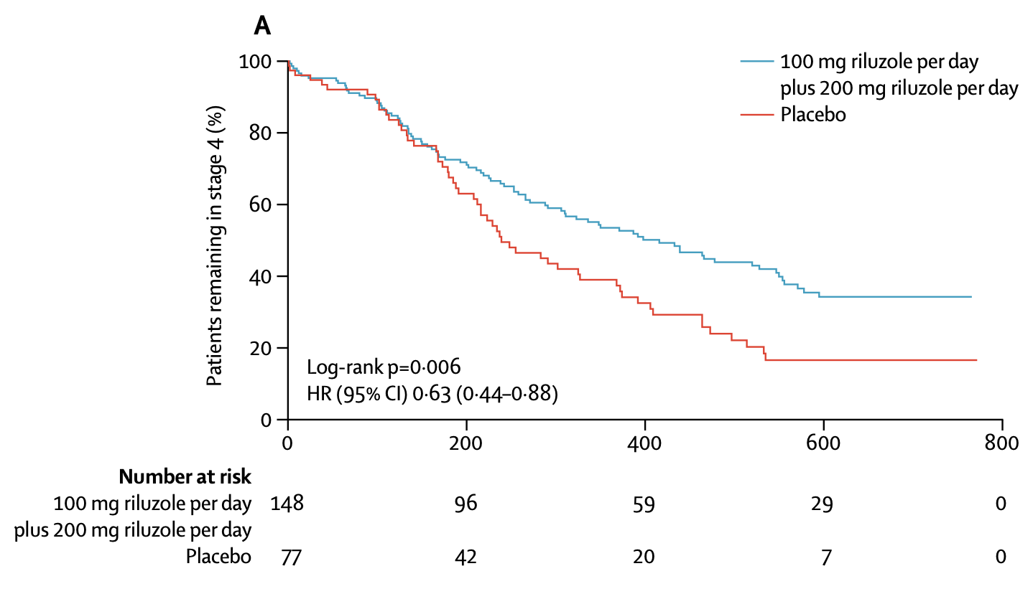
Stage 4 compared with placebo
Treatment with higher doses significantly prolonged time in stage 4 compared with placebo (p=0·006).

Slide 11
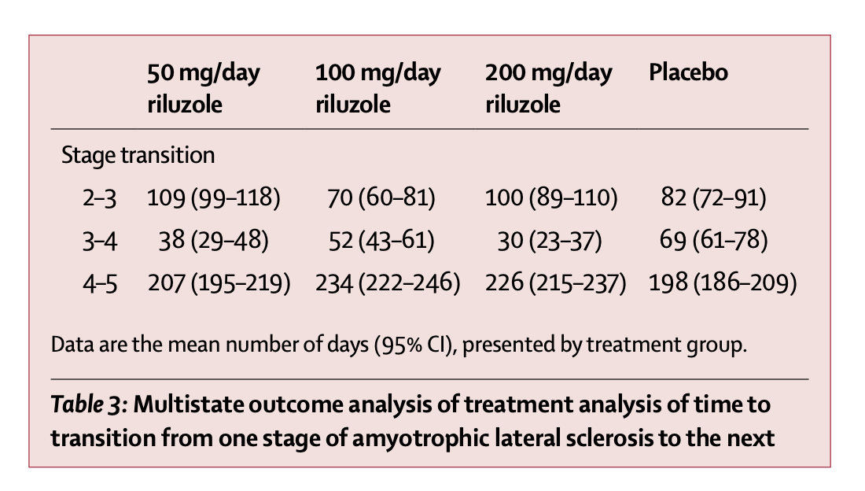

Slide 12

Better ways to measure outcomes
Fang T. Lancet Neurol 2018

Slide 13
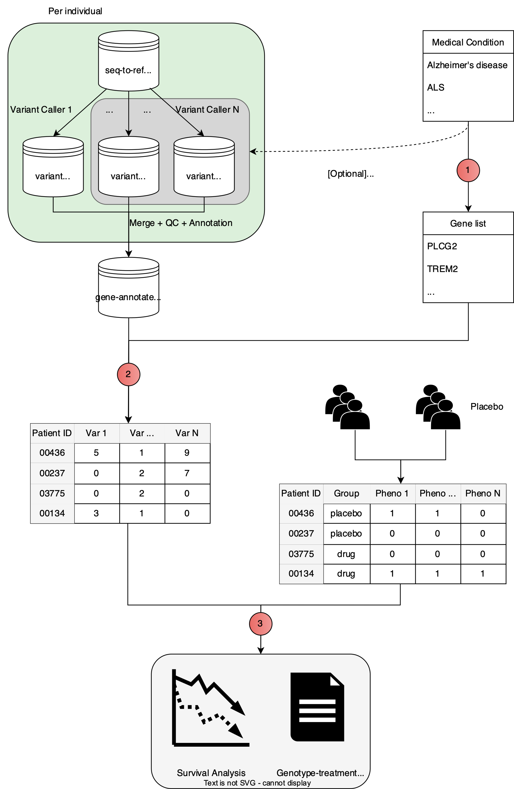

Slide 14
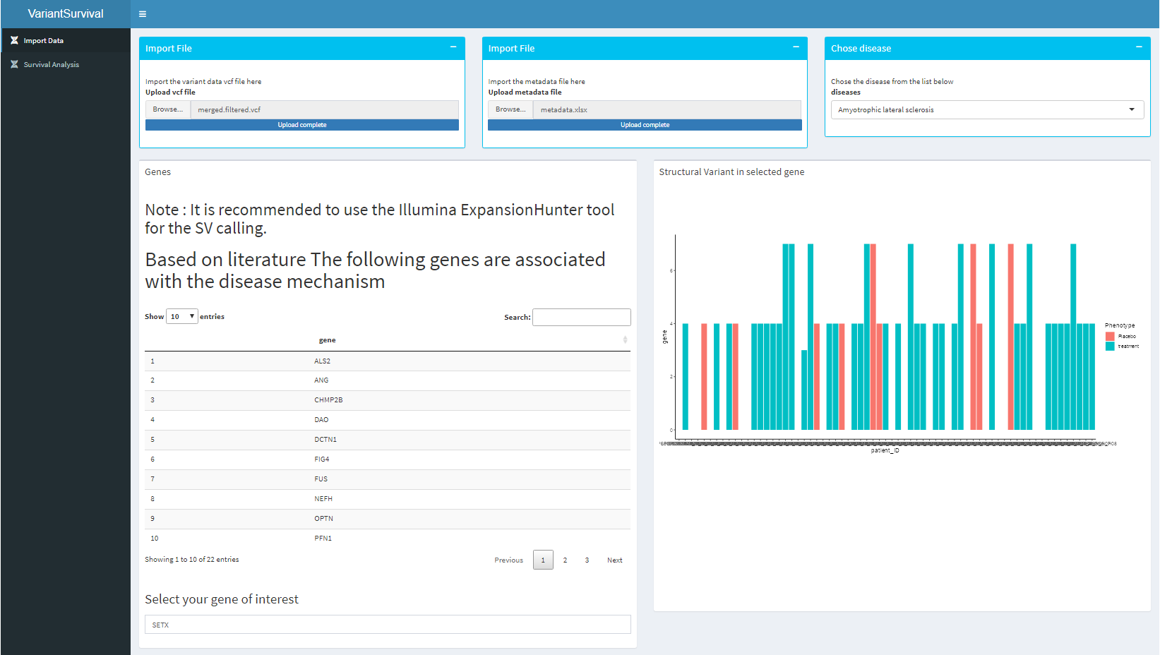

Slide 15
